Slide 1
Decision Making, Branching
if, if-else

Slide 2
Control Structures
A control structure refers to the order of executing the program statements.
The following three approaches can be chosen depending on the problem statement:
Sequential (Serial)
In a Sequential approach, all the statements are executed in the same order as it is written.
Selectional (Decision Making and Branching)
In a Selectional approach, based on some conditions, different set of statements are executed.
Iterational (Repetition)
In an Iterational approach certain statements are executed repeatedly.
Notes:
Control structures are used to alter the flow of execution of the program. Why do we need to alter the program flow ? The reason is “decision making“! In life, we may be given with a set of option like doing “Electronics” or “Computer science”. We do make a decision by analyzing certain conditions (like our personal interest, scope of job opportunities etc). With the decision we make, we alter the flow of our life’s direction. This is exactly what happens in a C++ program. We use control structures to make decisions and alter the direction of program flow in one or the other path(s) available.

Slide 3
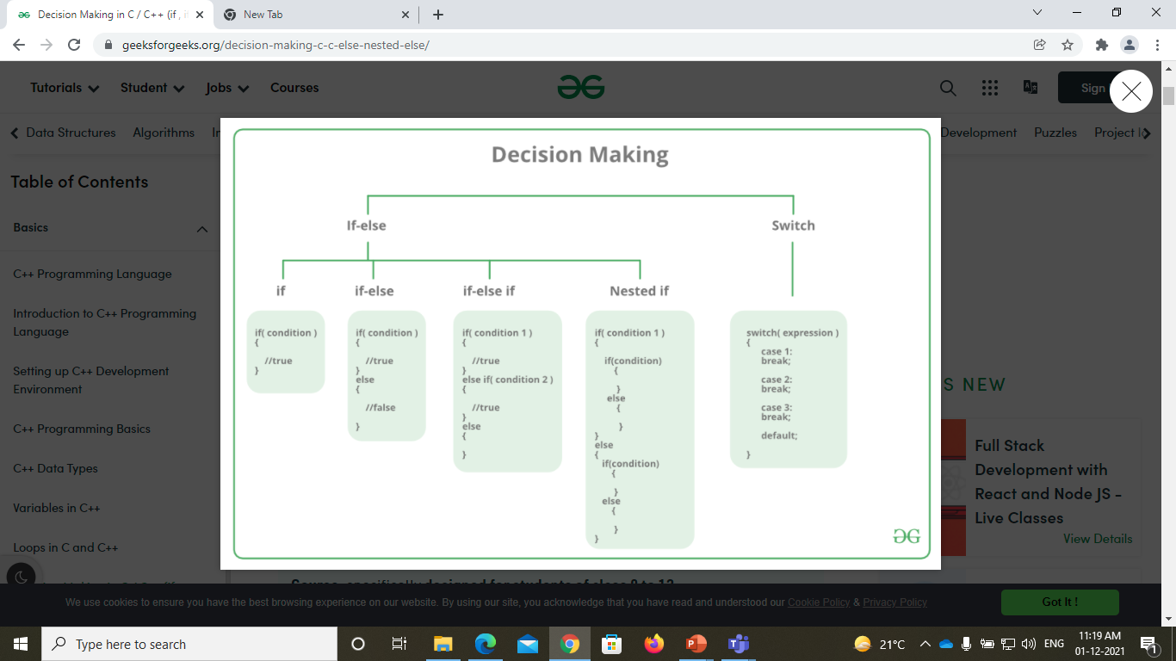

Slide 4
Different forms of if statement
1. Simple if statement.
2. if…else statement.
3. Nested if…else statement.
4. else if ladder
5. Jump Statements:
break
continue
goto
return

Slide 5
Simple if Statement
General form of the simplest if statement:
if (test Expression)
{
statement-block;
}
next_statement;
If expression is true (non-zero), executes statement.
It gives you the choice of executing statement or skipping it.

Slide 6
if Statement- explanation
(test Expression) is first evaluated.
If TRUE (non-zero), the ‘if’ statement block is executed.
If FALSE (zero) the next statement following the if statement block is executed.
So, during the execution, based on some condition, some
code will not be executed (skipped).
For example: bonus = 0;
if (hours > 70)
bonus = 10000;
salary= salary + bonus;

Slide 7
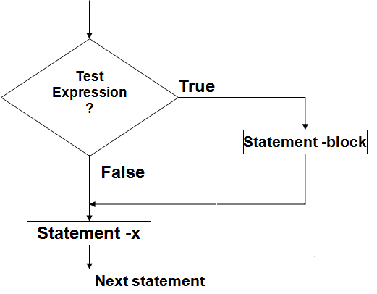
Flow chart of simple if
Entry

Slide 8
Find out whether a number is even or odd.
#include <stdio.h>
int main()
{
int x;
printf(“input an integer\n”);
scanf(“%d”,&x);
if ((x % 2) == 0)
{
printf(“It is an even number\n”);
}
if ((x%2) == 1)
{
printf(“It is an odd number\n”);
}
return 0;
}

Slide 9
Example - if
// Program to calculate the absolute value of an integer
int main ()
{
int number;
printf(“Type in your number: “);
scanf(“%d”,&number);
if ( number < 0 )
number = -number;
printf(“The absolute value is”);
printf(“%d”,number);
return 0;
}

Slide 10
The if-else statement
if (test expression )
{
statement _block1
}
else
{
statement _block2
}
Next_statement
if-else statement: enables you to choose between two statements

Slide 11
if-else statement
Explanation:
1.First ,the (test expression) is evaluated.
2.If it evaluates to non-zero (TRUE), statement_1 is executed, otherwise, if it evaluates to zero (FALSE), statement_2 is executed.
3.They are mutually exclusive, meaning, either statement_1 is executed or statement_2, but not both.
4.If the statements_ 1 and statements_ 2 take the form of block , they must be put in curly braces.
Example: if(job_code == 1)
rate = 7.00;
else
rate = 10.00;
prinf(“%d”,rate);

Slide 12
The if-else statement
yes
expression
no
Program statement 1
Program statement 2
Next _statement

Slide 13
Find out whether a number is even or odd.
#include <stdio.h>
int main()
{
int x;
printf(“Input an integer\n”);
scanf(“%d”,&x);
if ((x % 2) == 0)
{
printf(“It is an even number\n”);
}
else
{
printf(“It is an odd number\n”);
return 0;
}

Slide 14
WAP to find largest of 2 numbers
#include<stdio.h>
int main()
{
int a, b;
printf(“Enter 2 numbers\n”);
scanf(“%d %d”,&a,&b);
a;
else
cout<<"large is "<<fb;
return 0;
}
if(a > b)
printf(“Large is %d“,a);
else
printf(“Large is %d“,b);

Slide 15
Attention on if-else syntax !
if ( expression )
program statement 1
else
program statement 2
In C++, the ; is part (end) of a statement !
if ( remainder == 0 )
prinf("The number is even.\n“);
else
printf(“The number is odd.\n“);
Syntactically OK (void statement on if) but a semantic error !
if ( x == 0 );
printf(“The number is zero.\n“);

Slide 16
Example: determine if a year is a leap year
#include<stdio.h>
int main()
{
int year;
printf(“Enter the year“);
scanf(“%d”,&year);
if(year%4 == 0)
{
if( year%100 == 0)
{
if ( year%400 == 0)
printf("%d is a leap year",year);
else
printf("%d is not a leap year",year);
} else printf("%d is a leap year",year);
} else printf("%d is not a leap year",year);
return 0;
}
A leap year is exactly divisible by 4 except for century years (years ending with 00). The century year is a leap year only if it is perfectly divisible by 400.

Slide 17
Testing for character ranges
Output:
enter a character:
C
uppercase char
special char
enter a character:
j
lowercase char
special char
enter a character:
5
digit char
#include<stdio.h>
int main()
{
char ch;
printf(“enter a character\n”);
scanf(“%c”,&ch);
if (ch >= 'a' && ch <= 'z')
printf(“lowercase char\n“);
if (ch >= ‘A' && ch <= ‘Z')
printf(“uppercase char\n“);
if (ch >= ‘0' && ch <= ‘9')
printf(“digit char\n“);
else
printf(“ special char\n”);
return 0;
}

Slide 18
Testing for ranges
if (x >= 5 && x <= 10)
printf(“in range“);
?
if (5 <= x <= 10)
printf(“in range“);
?

Slide 19
Testing for ranges
if (x >= 5 && x <= 10)
printf(“in range“);
YES
if (5 <= x <= 10)
printf(“in range“);
Syntactically correct, but semantically an error !!!
Because the order of evaluation for the <= operator is left-to-right, the test expression is interpreted as follows:
(5<= x) <= 10 The subexpression 5 <= x either has the value 1 (for true) or 0 (for false). Either value is less than 10, so the whole expression is always true, regardless of x !
NO !

